Slide 1
Translating ELL strategies to the General Education Classroom
Luis Oviedo (Luiz Oliver) Kerri Whipple

Slide 2
Activity One:
ELL Teacher Vs. General Teacher
Who does what?
Work with your partner to go over the Venn Diagram and determine which tasks are done by the ELL teacher, General Ed. Teacher or both.
Notes:
Sample verbiage:
As we close out this section, let’s have a little fun with our last topic – [click] Student Navigation During Sessions.
To take the quiz, [click] open a browser to the following url or [click]download the Student Clicker – Socrative app.
When you are ready, [click] type in the room number listed on the screen.

Slide 3
ELL Teacher VS. General Ed.
Teach Vocabulary
Bridge Cultural Gaps
Social Emotional Development
Address Cultural needs
Teach Grammar
Provide rigor
Student Engagement
Differentiate Instruction
Provide a supportive environment

Slide 4
ELL Teacher VS. General Ed.
Teach Vocabulary
Bridge Cultural Gaps
Social Emotional Development
Address Cultural Needs
Teach Grammar
Provide rigor
Student Engagement
Differentiate Instruction
Provide a supportive environment

Slide 5
We are all a part of the effort to help students make the transition to a rich understanding of the English language.

Slide 6
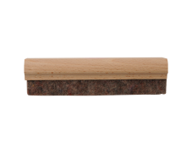
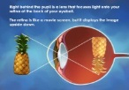
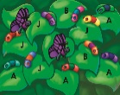
Strategies for supporting English Language Learners
Notes:
Sample verbiage:
The new Action Areas tool [click] not only provides current data for selected groups of students, but [click] also provides the means for you to intervene directly with a group of students right from the interactive tool panel.

Slide 7
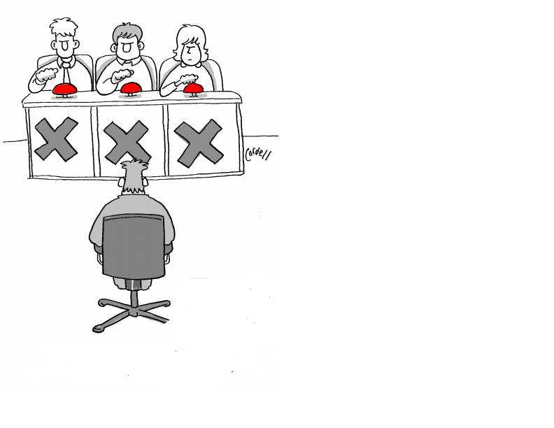

Slide 8
Strategy one:
Pre-teach and Use
Pre-Test results to plan lessons
Notes:
Sample verbiage:
The new Action Areas tool [click] not only provides current data for selected groups of students, but [click] also provides the means for you to intervene directly with a group of students right from the interactive tool panel.

Slide 9
Strategy two:
Implement an effective correction/feedback model
Notes:
Sample verbiage:
The new Action Areas tool [click] not only provides current data for selected groups of students, but [click] also provides the means for you to intervene directly with a group of students right from the interactive tool panel.

Slide 10
Strategy three:
Create a language-rich environment.
Notes:
Sample verbiage:
The new Action Areas tool [click] not only provides current data for selected groups of students, but [click] also provides the means for you to intervene directly with a group of students right from the interactive tool panel.

Slide 11
Ways to create a Language rich environment
Read out loud every day
Word Walls
Create a Diverse Library
Play with words
Search for rich language while reading
Encourage rich language while writing
Notes:
Sample verbiage:
As we close out this section, let’s have a little fun with our last topic – [click] Student Navigation During Sessions.
To take the quiz, [click] open wa browser to the following url or [click]download the Student Clicker – Socrative app.
When you are ready, [click] type in the room number listed on the screen.

Slide 12
Strategy four:
Support academic language development
Notes:
Sample verbiage:
The new Action Areas tool [click] not only provides current data for selected groups of students, but [click] also provides the means for you to intervene directly with a group of students right from the interactive tool panel.

Slide 13
Strategy five:
Incorporate visuals as much as possible
Notes:
Sample verbiage:
The new Action Areas tool [click] not only provides current data for selected groups of students, but [click] also provides the means for you to intervene directly with a group of students right from the interactive tool panel.

Slide 14
Strategy six:
Discuss word families and how different forms of words are used
Notes:
Sample verbiage:
The new Action Areas tool [click] not only provides current data for selected groups of students, but [click] also provides the means for you to intervene directly with a group of students right from the interactive tool panel.

Slide 15
Strategy seven:
Provide student with frequent opportunities to work together, both in pairs and in small groups.
Notes:
Sample verbiage:
The new Action Areas tool [click] not only provides current data for selected groups of students, but [click] also provides the means for you to intervene directly with a group of students right from the interactive tool panel.

Slide 16
Strategy eight:
Be aware of the relationship between a student’s native language and English
Notes:
Sample verbiage:
The new Action Areas tool [click] not only provides current data for selected groups of students, but [click] also provides the means for you to intervene directly with a group of students right from the interactive tool panel.

Slide 17
Great Article to read!!!
Learner English Second Edition: A teacher’s Guide to interference and other problems
http://assets.cambridge.org/97805217/79395/frontmatter/9780521779395_frontmatter.pdf
Notes:
Sample verbiage:
As we close out this section, let’s have a little fun with our last topic – [click] Student Navigation During Sessions.
To take the quiz, [click] open wa browser to the following url or [click]download the Student Clicker – Socrative app.
When you are ready, [click] type in the room number listed on the screen.

Slide 18
Here are a few differences between
Spanish and English:
The consonants: v, h, j, r, z, ñ, x
The blends: ll, and rr
Combinations in Spanish that are pronounced differently: que, qui, güe, güi. For example: the u is not pronounced unless it is written as ü; therefore, students may not be sure how to pronounce words like queen, quiet, or quick
Quotation marks vs. dashes: "Come here," he said. –Ven aquí–le dijo.
Notes:
Sample verbiage:
As we close out this section, let’s have a little fun with our last topic – [click] Student Navigation During Sessions.
To take the quiz, [click] open wa browser to the following url or [click]download the Student Clicker – Socrative app.
When you are ready, [click] type in the room number listed on the screen.

Slide 19
Spanish does not have the following sounds :
Vowel diagraphs: ou, ow, eigh, au, aw, oo
Consonant digraphs: sh, th, wh, ph
Consonant blends: sl, sm, sts, scr, spr, str
Initial sounds: kn, qu, wr, sk
Final sounds: ck, ng, gh
Endings: -ed (pronounced /d/ or /t/ or /ded/ or /ted/)
Endings: -s (pronounced /s/ or /z/ or /ez/ or /es/)
Endings without a vowel: -ps, -ts
Suffixes/prefixes: un-, over-, under-, -ly, -ness, -ful, -est
Contractions: don't, isn't, weren't, etc.
Notes:
Sample verbiage:
As we close out this section, let’s have a little fun with our last topic – [click] Student Navigation During Sessions.
To take the quiz, [click] open wa browser to the following url or [click]download the Student Clicker – Socrative app.
When you are ready, [click] type in the room number listed on the screen.

Slide 20
Strategy nine:
Create more opportunities for Collaborative work
Notes:
Sample verbiage:
The new Action Areas tool [click] not only provides current data for selected groups of students, but [click] also provides the means for you to intervene directly with a group of students right from the interactive tool panel.

Slide 21
interactive learning
peer tutoring
shared learning
interactive activities
buddy reading
independent projects
cooperative learning
journaling
Collaborative Practice
Notes:
Sample Verbiage: Let’s pair up the students and print out the book for them to practice their fluency and reading together.

Slide 22
Strategy ten:
Collaborate with your ESL team as well as the global community of teachers
Notes:
Sample verbiage:
The new Action Areas tool [click] not only provides current data for selected groups of students, but [click] also provides the means for you to intervene directly with a group of students right from the interactive tool panel.

Slide 23
Strategy eleven:
Allow for students to adjust to the change
Notes:
Sample verbiage:
The new Action Areas tool [click] not only provides current data for selected groups of students, but [click] also provides the means for you to intervene directly with a group of students right from the interactive tool panel.

Slide 24
Strategy twelve:
Allow for support from the first language if possible
Notes:
Sample verbiage:
The new Action Areas tool [click] not only provides current data for selected groups of students, but [click] also provides the means for you to intervene directly with a group of students right from the interactive tool panel.

Slide 25
Strategy thirteen:
Look out for culturally unique vocabulary
Notes:
Sample verbiage:
The new Action Areas tool [click] not only provides current data for selected groups of students, but [click] also provides the means for you to intervene directly with a group of students right from the interactive tool panel.

Slide 26
Native-Like English Proficiency
textbook language
non-verbal
communication


reading
formal
humor
written
text


basic, social & day-to-day communication
analogy and abstractions
⬥
culture
❖
cohesion
specialized terminology
◆
lectures
Years
Notes:
taken from the work of Mary Meyers and could nicely illustrate the Years to achieve native language proficiency
FROM Teaching to Diversity: Teaching and Learning in the Multi Ethnic Classroom

Slide 27
Strategy fourteen:
Use sentence frames to give student practice with academic language
Notes:
Sample verbiage:
The new Action Areas tool [click] not only provides current data for selected groups of students, but [click] also provides the means for you to intervene directly with a group of students right from the interactive tool panel.

Slide 28
Activity Two:
Roles of the ESL Teacher
What do you see as your role in the classroom?
Discuss with your neighbor. You will have three minutes to complete the activity.
Notes:
Sample verbiage:
As we close out this section, let’s have a little fun with our last topic – [click] Student Navigation During Sessions.
To take the quiz, [click] open a browser to the following url or [click]download the Student Clicker – Socrative app.
When you are ready, [click] type in the room number listed on the screen.

