Slide 1
Instructional Practices to Meet the Needs of Students with Content Gaps
Bobbie K. Kilber
Master of Science in Education: Leadership and K-12 School Administration
ENL endorsed
Instructional Specialist for SD Statewide Title III and Migrant Consortia
Black Hills Special Services Cooperative
Resources used for this presentation…
Migrant Literacy Net www.migrantliteracynet.com
“Why Context Is Just as Important as Content in the Classroom” http://www.edudemic.com/context-in-the-classroom/ By Joni Nguyen
https://www.princeton.edu/futureofchildren/publications/docs/21_01_05.pdf
And… The Teachers Our English Language Learners Need from Educational Leadership/February 2016 www.ascd.org

Slide 2
Goals for Today
Learn how to utilize Migrant Literacy Net – a free resource for South Dakota’s migrant students and families
Learn what we as educators and administrators can do to try to close/eliminate content gaps

Slide 3
What is an achievement gap? “The “achievement gap” in education refers to the disparity in academic performance between groups of students. The achievement gap shows up in grades, standardized-test scores, course selection, dropout rates, and college-completion rates, among other success measures… In the past decade, though, scholars and policymakers have begun to focus increasing attention on other achievement gaps, such as those based on sex, English-language proficiency and learning disabilities.”
Editorial Projects in Education Research Center. (2011, July 7). Issues A-Z: Achievement Gap. Education Week. Retrieved October 2017 from http://www.edweek.org/ew/issues/achievement-gap/

Slide 4
The content of this presentation contains information that will benefit all, but is specifically designed for those who work with Migrant Learners, SLIFE (Students with Limited and/or Interrupted Formal Education, English Learners, and all other students who struggle…

Slide 5
Some statistics… There are Large Gaps in Academic Outcomes for EL’s according to 2013 NAEP
Native English Speakers
English Learners
25% of 8th graders were below basic in mathematics
21% of 8th graders were below basic in reading
Scores were similar for grade 4
69% of 8th graders were below basic in mathematics
70% of 8th graders were below basic in reading
Scores were similar for grade 4

Slide 6
Students who are not proficient in four essential domains—listening, speaking, reading, and writing—but are no longer classified as LEP continue to struggle with reading and academic coursework. Migrant English learners, another group of English learners, are mainly U.S.-born but lack proficiency in English because their education is interrupted as their parents follow the crops from state to state.
https://www.princeton.edu/futureofchildren/publications/docs/21_01_05.pdf
What can we do to help these students succeed?
What instructional practices provide the greatest benefits for these students?
How do we close/eliminate content gaps?

Slide 7
These students need MORE of everything!!!
More time to learn
More patience from educators
More language and content modifications
More (better) understanding of their needs
More work with fundamental skills
More positive, open, and experiential (field trip) learning opportunities
More opportunities to participate in classroom activities
More goal oriented approaches – with clear objectives, steps to be accomplished, and assessments to determine mastery
More time to “do” things, rather than only listening, reading, & writing
More small group activities that require active participation
Project based learning

Slide 8
Best Classroom Techniques
Establish routines
Utilize Graphic Organizers
Choral poetry reading
Class books
Autobiography and Biography Collage Project
Listening and Reading with Audio Books
Vocabulary Books – explicit vocabulary instruction is crucial!
Story Development practice
Peer Review
Wh- question practice
Sentence Frames
Mobile Hangers
Adaptation of Texts
Field Trips
Cooperative Learning
Reduce amount of material, but continue to provide repetition of skills
Simplify language, NOT cognitive requirements

Slide 9
What else can you (we) do?
1. Gather baseline data, use that data to drive instruction, post-testing
2. Create rich small group or one on one learning experiences
3. Consider your classroom arrangement: student-centered, collaborative
4. Be approachable to your students & work to establish relationships in order to build student confidence
5. Teach your students to become active learners and draw on the backgrounds of your students
6. Listen to your students in order to connect and understand them
7. Provide opportunities for the following… Catch-up growth, building background/scaffolding, building content and vocabulary knowledge, while meeting interests and learning styles
Make sure that your students are
ENGAGED, MOTIVATED, and FEELING SUPPORTED!!!

Slide 10
For Students with Limited and/or Interrupted Formal Education (SLIFE)
Four key elements to academic success for this population:
Students must be engaged in a challenging, theme based curriculum
Teachers need to draw on students’ backgrounds
Teachers need to plan and promote collaborative activities and utilize scaffolded instruction
Work to build student confidence. They must believe they are able, capable learners and they must value their schooling.

Slide 11
In order to close/eliminate content gaps, we must… realize the importance of content and *context, advocate, scaffold, make content comprehensible, build background knowledge, provide explicit instruction, motivate, engage, use research-based strategies, seek professional development, and so much more…
*Context helps us…
Understand our students
Frame the learning experience
Define success
Become better educators: to inspire, empower, & advise our students

Slide 12
Context is a very real issue for today’s classrooms that can contribute to the achievement gaps.
From “Why Context is Just as Important as Content in the Classroom” by Jody Nguyen 4/16
Context consists of a classroom’s characteristics, the way a teacher chooses to manage the daily concerns that indirectly does shape the perceptions of his/her students.
such as… student body, classroom structures, routines, resources
-Does NOT include the teacher’s ability to teach the content-

Slide 13
Explicit Vocabulary Instruction is Crucial!!
Students benefit most when teachers provide rich and varied language experiences
teach individual words, noun phrases, and idioms
teach word-learning strategies, such as looking for prefixes and root words
foster word consciousness that makes clear the importance of learning as many words as possible throughout the day
frequent exposure to a word in multiple forms
ensuring understanding of meaning(s)
providing examples of its use in phrases, idioms, and usual contexts
ensuring proper pronunciation, spelling, and word parts
teaching its cognates, or a false cognate, in the child’s primary language

Slide 14
If you are searching for a free resource to meet the needs of migrant students with content gaps… look to migrantliteracynet.com
Migrant Literacy Net could be a great addition to your program!!

Slide 15
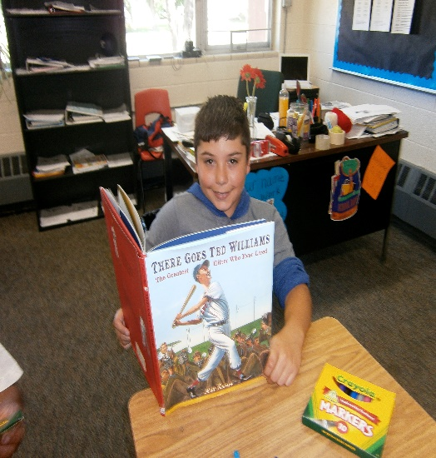
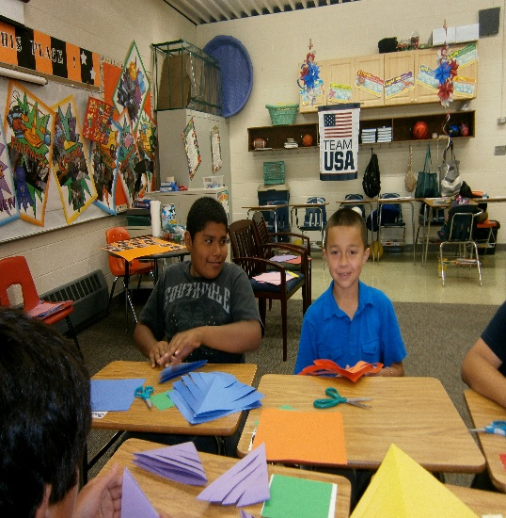
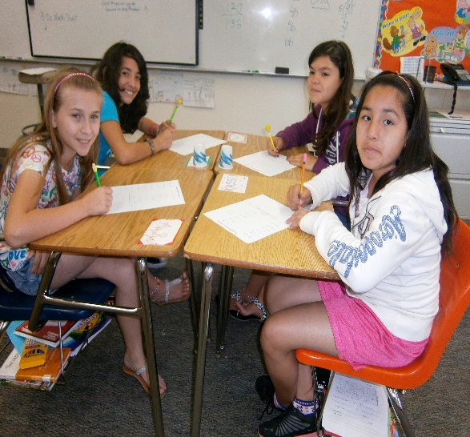
Migrant Literacy NET Teachers Guide: November 2017 Lessons and Supplemental Instructional Tools

Slide 16
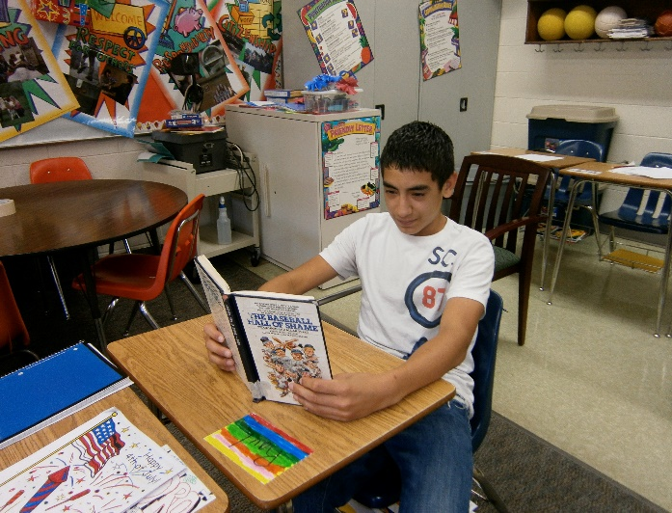
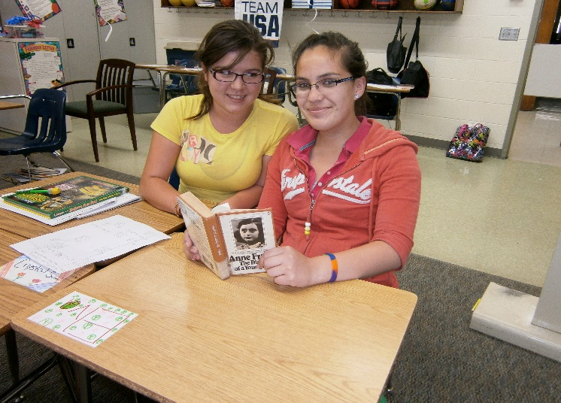
Purpose
In order to assist migrant students in grades K-12 and out-of-school youth to become proficient in literacy (reading, writing, and study skills) and overcome barriers to high school graduation.
www.migrantliteracynet.com

Slide 17
Available Resources with Migrant Literacy Net
One hundred forty-one reading lessons across the five reading dimensions at the K-12 level and for OSY (field tested and complete)
Thirty-one additional literacy lessons in English/Spanish (field tested and complete)
Reading and writing resources for parents to assist their children to read (in English and Spanish)
Eighty-six writing lessons (field tested and complete)
Forty-forty math lessons in English/Spanish (field tested and complete)
Eleven study skills lessons (field tested and complete)
Sixteen OSY lessons (field tested and complete)
Pre and post test assessments for each lesson
Electronic Success Plans to track student progress online that can be transferred electronically to teachers anywhere
Electronic Graduation Plans to help overcome barriers to success
Two-hundred-sixty online reading tutorials in both English & Spanish which students can access anywhere.
On-line screeners to identify specific reading needs in both English & Spanish

Slide 18
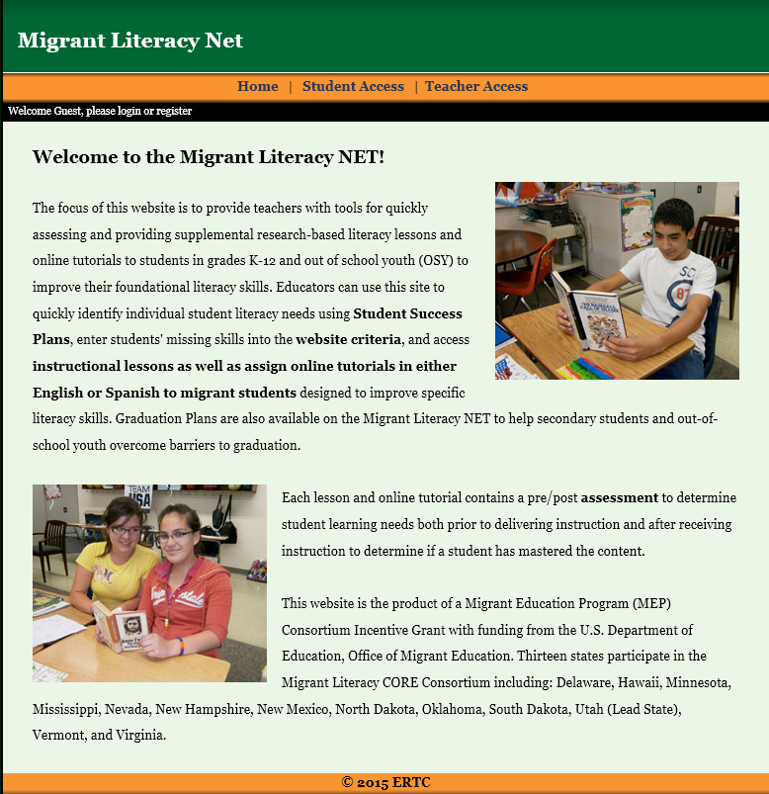
www.migrantliteracynet.com
Click on:
‘Teacher Access’

Slide 19
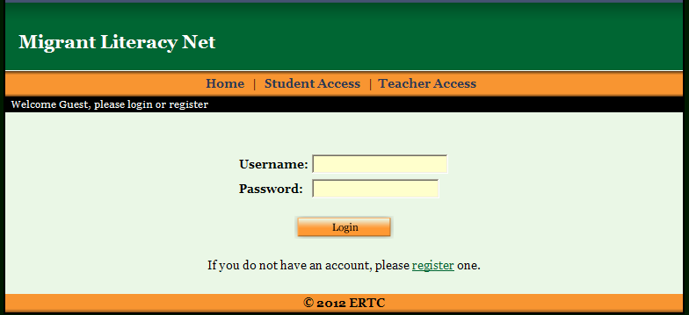
Enter your user name and password or click on register to create your own

Slide 20
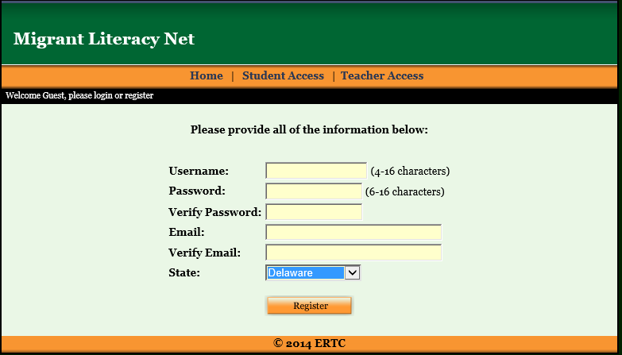
Create your own user name and password

Slide 21
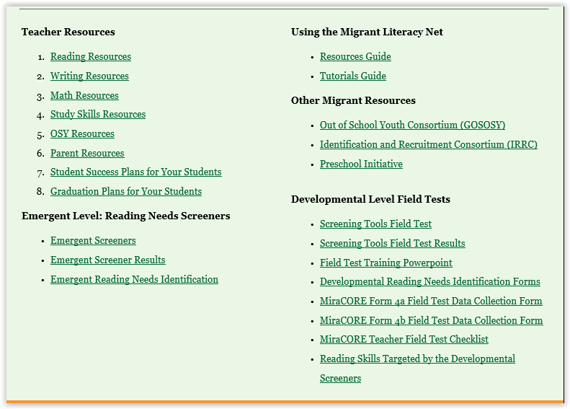
Web-based system with a wide variety of resources for teachers

Slide 22
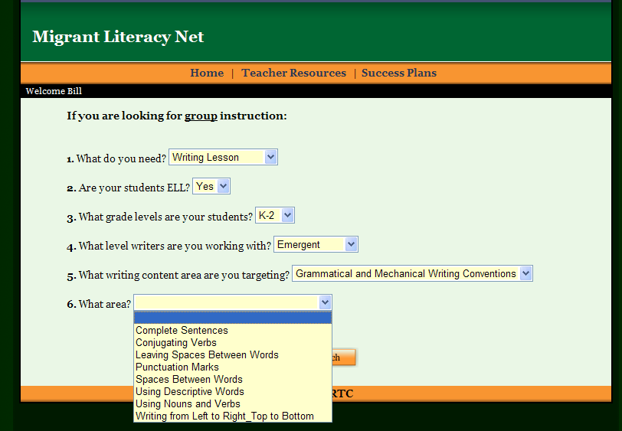
Teachers can search for lessons to meet student needs.

Slide 23
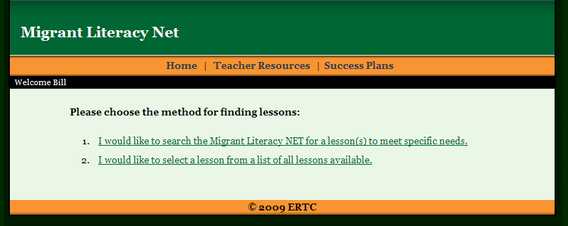
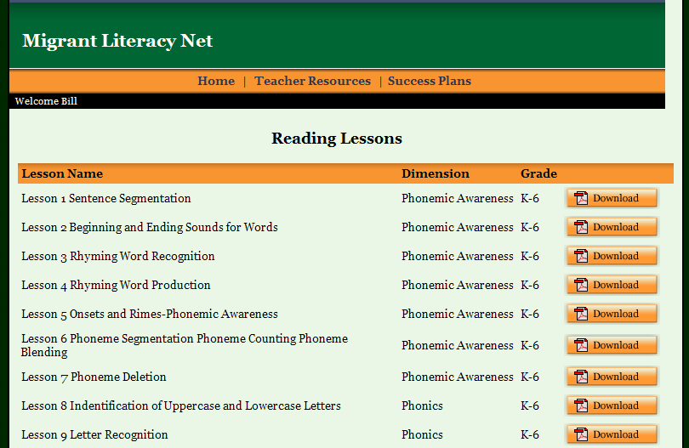
Teachers can select lessons from a list.

Slide 24
Migrant Literacy Net Lessons (Reading, Writing, Math & Study Skills)
Lessons include all teacher procedures, timelines, student materials, worksheets, assessments, as well as ELL considerations.

Slide 25
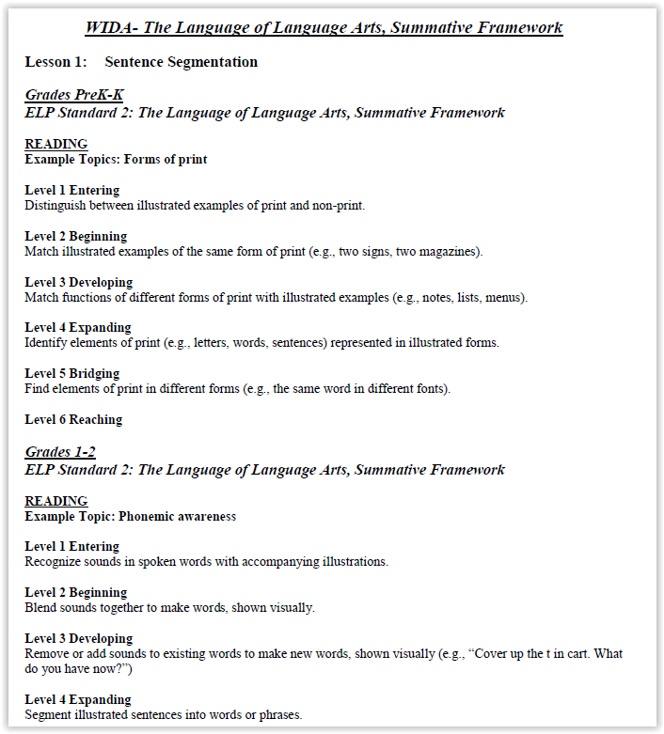
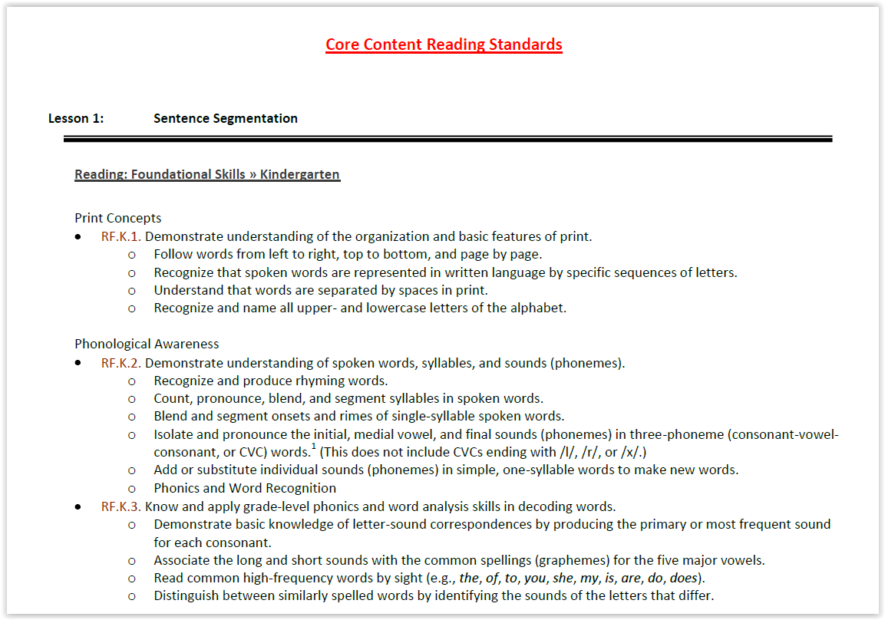
All lessons are mapped to Common Core State Standards & WIDA standards.

Slide 26
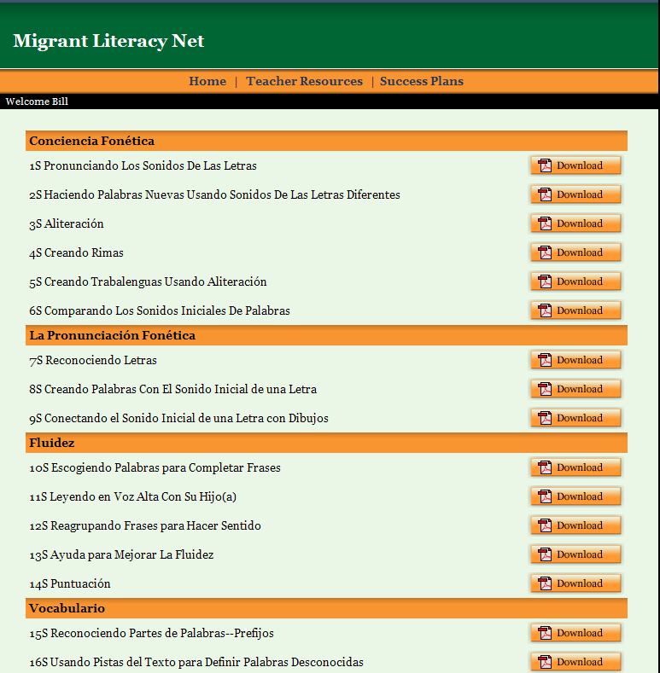
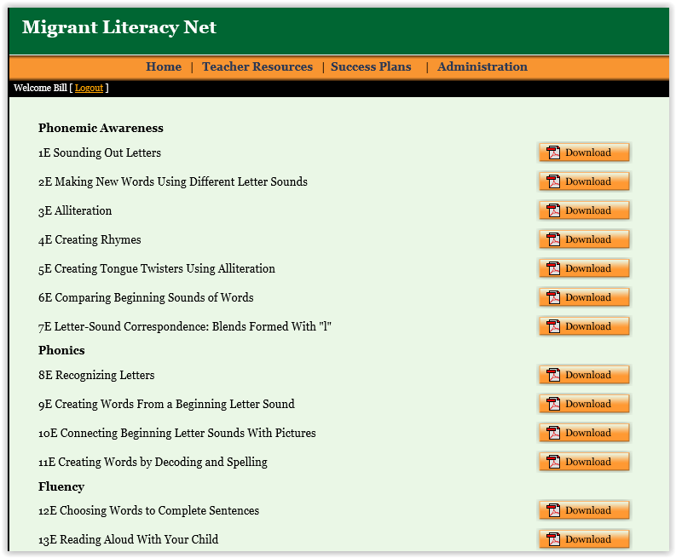
Resources for parents are available in English/Spanish to assist in helping their children to learn to read.

Slide 27
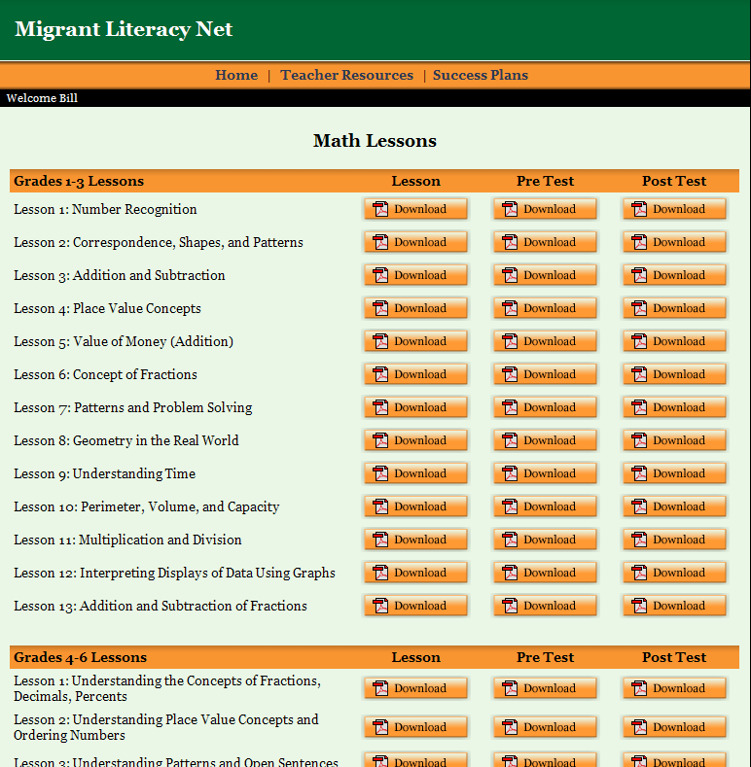
Resources in Mathematics are also available in English & Spanish.

Slide 28
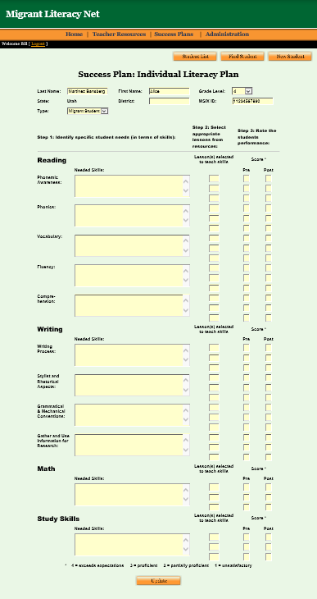
Teachers can create individual learning plans for ALL students and track progress.

Slide 29
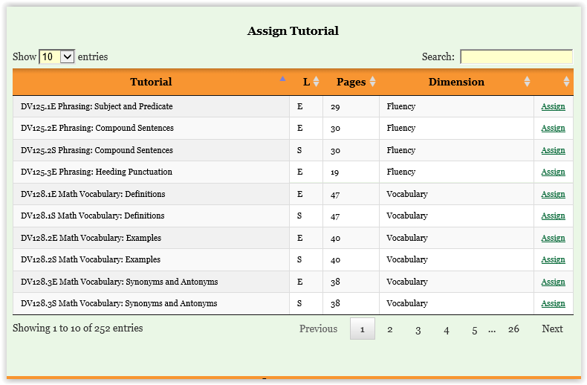
Teachers can assign online reading tutorials to students at the bottom of the success plans.

Slide 30
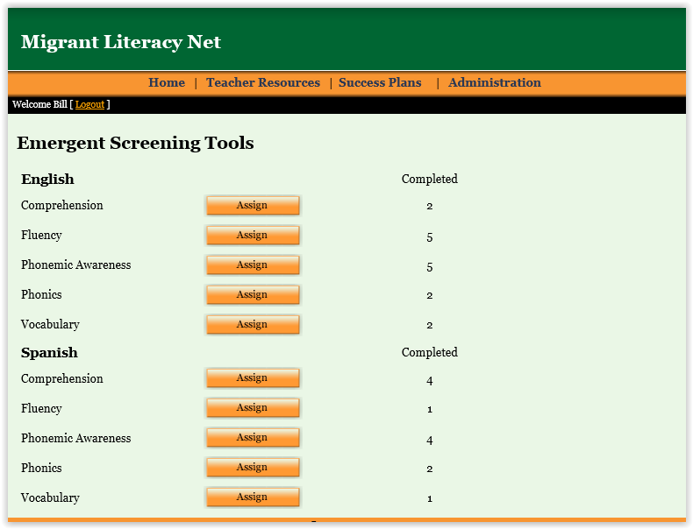
Teachers can assign online reading screeners to identify student specific reading needs.

Slide 31
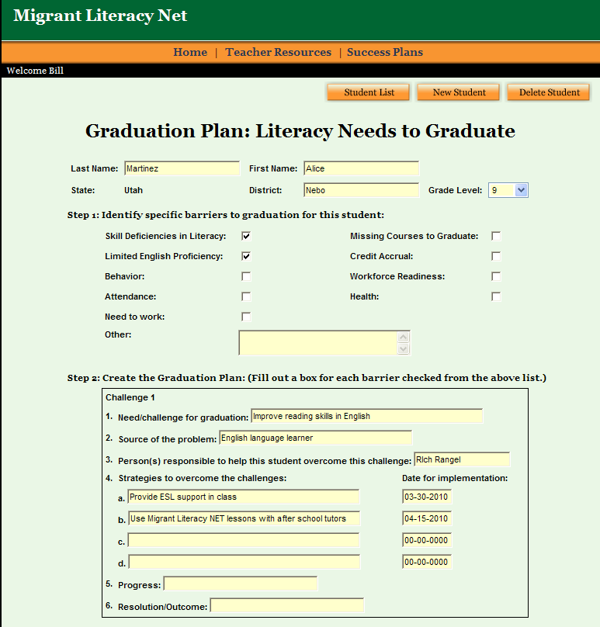
Teachers can create Graduation Plans for students to assist in overcoming barriers to completion.

Slide 32
Barriers to Achievement
Researchers, experts and advocates (NCBE, 2001; Kindler, 2002; Branz-Spall et al, 2003; Fránquiz & Salinas, 2004; LaCroix, 2007; USDE, 2006; NCES, 2010) have identified some of the following factors as key challenges jeopardizing migrant students' chances to excel academically and later in life:
These include a lack of:
Access to fully-qualified or adequately prepared teachers and staff
Enrollment in rigorous, college preparatory coursework
Participation in challenging grade-level content coursework if students are EL’s
Resources for unmet instructional needs
Knowledge about and access to information on higher education or post-secondary vocational options

Slide 33
Other challenges include:
Inconsistent attendance
Gaps in content due to missed instructional and assessment time
lack of continuity with academic standards, curriculum, expectations, instructional programs, and school environments
Difficulty keeping track of high school credits earned for graduation if students attend multiple schools in different states – South Dakota is doing great things to overcome this challenge. Our SD DOE has implemented an electronic educational tracking system.

Slide 34
Helping students succeed
Welcoming Students & Families
Create a positive and welcoming classroom environment by modeling respect for differences
Allow families and students to share experiences and values
Help families become familiar with our culture, school activities
Provide information in parents’ primary language
Let’s take some time to explore what this looks like in your district and brainstorm ideas for enhancing all of the good things already happening in your school.
Please record ideas on chart paper…

Slide 35
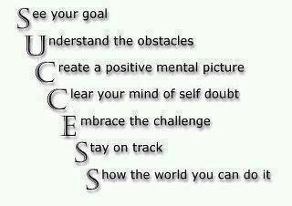
Helping Migrant students succeed
www.colorincolorado.org
Encouraging Academic Success
Implement research-based methods
Expose students to the more academically rigorous coursework and content that mainstream students do
Hold students to high expectations
Use cooperative learning strategies

Slide 36
Enjoy your day!
To Increase Collaboration and Professional Development
Reach out to me at bobbie.kilber@k12.sd.us
Reach out to colleagues within your school or via social networking sites to share best practices, resources, tools, information, etc.
Look to our website …
sdtitle3migrant.org
Thank you for coming today. Please email me if you would like additional information about specific instructional practices.

